Slide 1
K-Nearest Neighbors algorithm
Name : Maryam Zubair
Student Id : 19709

Slide 2
KNN in Python
Introduction
Design
Implementation
Testing
Enhancement
Conclusion
Bibliography/References

Slide 3
Introduction:
I aim to develop a fall prediction system using accelerometer and gyroscope dataset. The goal is to accurately predict the likelihood of a fall in real-time.

Slide 4
Design:
In this project, we are finding the fall prediction by calculating the Euclidean Distance manually and will try to identify the nearest number of data points to a given test data point. Later on we will be applying K Nearest Neighbour algorithm on the same datasets, which is mostly used for classification problems where the goal is to accurately predict the label for a given input sample.

Slide 5
Mathematical Implementation :
Formulas Used for Mathematical Calculations
Euclidean Distance = Distance to each neighbor
= ( TargetX1 - DataX1 ) ^ 2 + ( TargetY1 - DataY1 ) ^ 2 + …..
K = sqrt ( no. of data samples)
= sqrt (8) = 3 (if the answer is even number then pick the next odd number)
Based on K=3 , picking 3 nearest neighbours to predict the output
Prediction = Positive

Slide 6
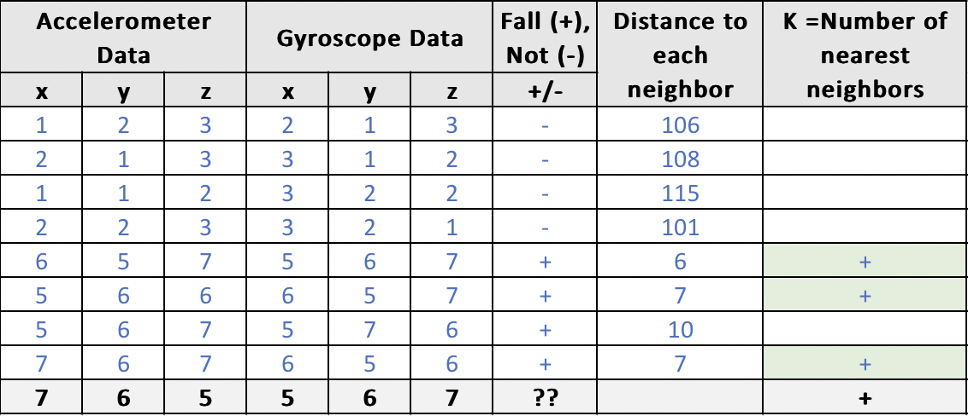
Result:

Slide 7
Code Implementation :
Defined method for calculating Euclidean Distance between the two rows in dataset.
Defined method for finding Nearest Neighbour to identify the nearest "K" number of data points to a given test data point.
Defined method to make a prediction for the test data point based on their class labels. Prediction is made by taking a majority vote among the "K" neighbors so whichever class label appears most frequently among the neighbors is considered the predicted class.

Slide 8
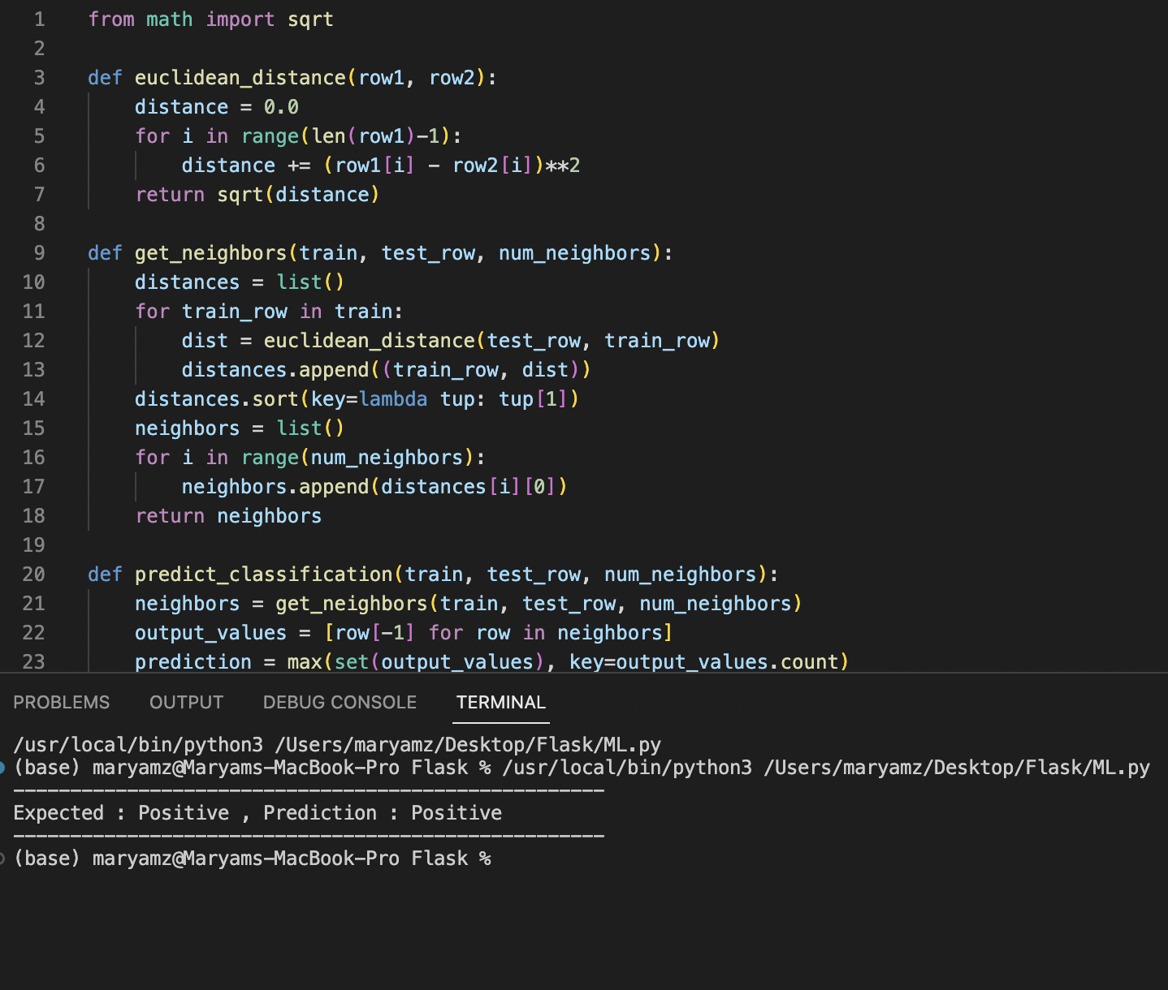
Result:

Slide 9
Enhancement Ideas
In future we can Improve the program by considering following factors:
Using numpy library as it performs mathematical operations faster than normal python implementation.
Splitting the data into training and testing for more accurate results
Hyperparameter tuning for the Model performance: Number of neighbors (K) can be determined by using techniques such as cross-validation or grid search.
Weighted k-NN: Instead of giving equal weight to all the k nearest neighbors, we can give more weight to the neighbors that are closer to the test instance.

Slide 10
Conclusion:
We had predicted the class label for test data both manually and by KNN algorithm. The result could be either "Positive" or "Negative" depending on the actual class label. In our Problem the result was “Positive” when checked through both methods.

Slide 11
Bibliography/ References
How to Evaluate and Improve KNN
Weighted k-NN Classification
https://medium.datadriveninvestor.com/k-nearest-neighbors-in-python-hyperparameters-tuning-716734bc557f

